Slide 1
Mobility Showcase
Akta Jain, Umesh Katkol, Mathew BasilThomas

Slide 2




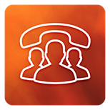





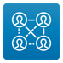
















Dell Mobile Application Portfolio
Production Applications Driving High-Value Business Interactions
Team Member Productivity
Sales & Prospect Enablement
Practitioner Engagement
Executive Portfolio
EZ Dialer
VxRail To Go
RSA Archer
GRC Reports
Events
myQuote Approvals
My Campus
Help-A-Customer
Engage
GeM Tracker
Burn Notification
vApprove
Spaces
Tricorder
My Orders
Sales Dashboard
EZ OrgChart
My Sales
ERG Connect
APJ Dashboard
Help
E-Lab Navigator
DSC Supplier Profile
My Guest
Hack Platform

Slide 3


Enterprise Mobile Engineering (EME) Strategies
Platforms
Mobility Governance & Support
App Upgrade
Aunthen- tication
Prebuilt Security/Performance Evaluated Mobility Solutions from EME
Single Entry-Exit Point for all Mobile Solutions
GTM
Develop Solutions Together
A repository of performance evaluated prebuilt reusable components that can be plugged into any Dell solutions.
Mobility Solution Offering
CI/CD
Rearchitected the Platform building Support and Monitoring aspects
a. 12000 Cumulative Mobile user base
Migration from Airwatch to WS1 (towards Northstar)
a. 46,400 employees migrated to WS1
b. 22 Apps successfully deployed to WS1
Established credible ownership for Mobile App Governance & GTM
Responsible to ensure all the mobile apps are compliant around Legal, Branding and Security guidelines.
Adherence to all Mobile Standards is ensured before deploying apps onto internal and external Dell platforms
114 successful deployment in FY20 YTD
Push Notification
Mobile First = Digital Transformation = Simple & Quick
Establishing Trust & Credibility
Scaling to Enterprise Apps
Monitoring
Legal
a. Push Notification
A reusable library that can be easily integrated into any App
33 different types of notifications are supported, including scheduled, mobile, EMAIL, Wearables etc
128,272 notifications sent through Push notification Platform
Mobile Buss. Enablement
Platforms
Branding
Secure Browser Container
b. Self Service Portal
Build your own mobile native app in less than 3 hours.
16+ apps developed using this Portal deployed in Production
Self-Service Portal*
Mobility Standards
Security
c. Monitoring and Instrumentation set up
7 Layers of Complex architecture
Both proactive and reactive monitoring setup
98 + APIs created for application monitoring
Support model defined
Provide Consultation
Remote Config.
Hosting
Native
End-to-End Mobility Solution
App Signing

Slide 4



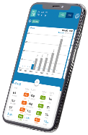
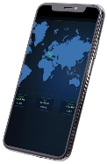
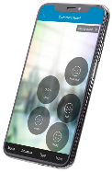
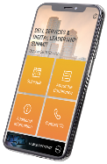




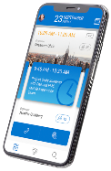
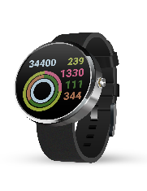
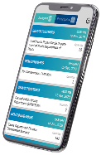
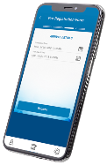



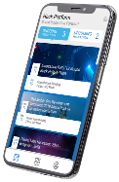
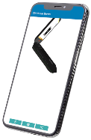
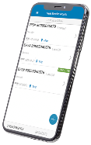
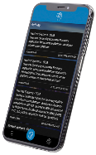
Demo Apps
1
2
3
4
GRC Reports
Sales Dashboard
Help A Customer
Events
Empowering All Dell mobile application for the executives to view the weekly/quarterly forecast along with current revenue, margin details with drill down functionality for world-wide leadership team
It shows the real time sales and revenue information across globe
Empowering All Dell Team Members to Engage as Customer Advocates
This app enables the user to check the details and schedules of an oncoming registered event
5
6
7
8
Engage
Burn Notification
GeM Tracker
My Guest
Connect to your meetings, calendar and colleagues, all in one easy to use place. Find content from Dell’s web properties.
Android Mobile and smart watch app which will be used to check/monitor the software burn status within Dell factory. It is an intelligent Information systems for Storage ET operators
A mobile application for the business partner (India Sales Teams) to assign and track the bids for the Government e Marketplace tenders
An innovative All-Ireland solution for registering visitors to visit our buildings.
Hack
9
3D Viewer
10
E-Lab Navigator
11
12
Tricorder
Hack platform is an application which provides the podium to host hackathon, vote for your favourite team, submit ideas, submit problem statements.
A 3D Model Viewer application is developed to showcase 3D rendering of laptop based on the image detected by phone camera. User can able to rotate & check all
Easy Customer and Partner Access to View, Save & Share e-Lab Certified Configurations
Simplifying the Solution Selling Process for Sales Teams Engaging with Customers & Prospects

